Slide 1
ARRIBADA CLUB
Computer Information

Slide 2
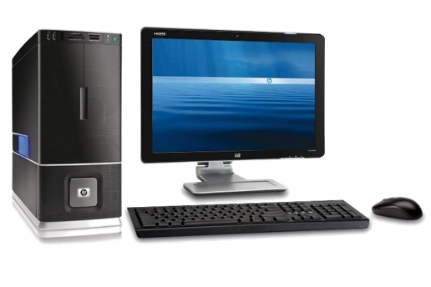
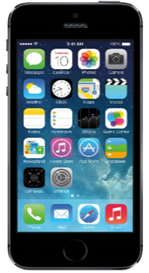
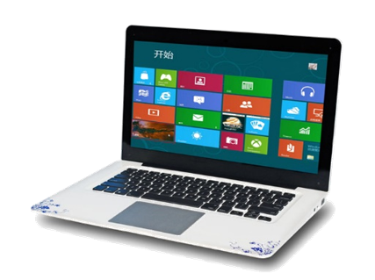
Which of these are computers?

Slide 3
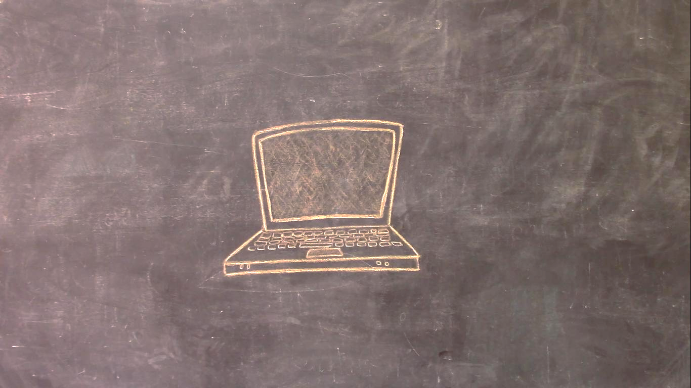
What can we find in a computer?

Slide 4
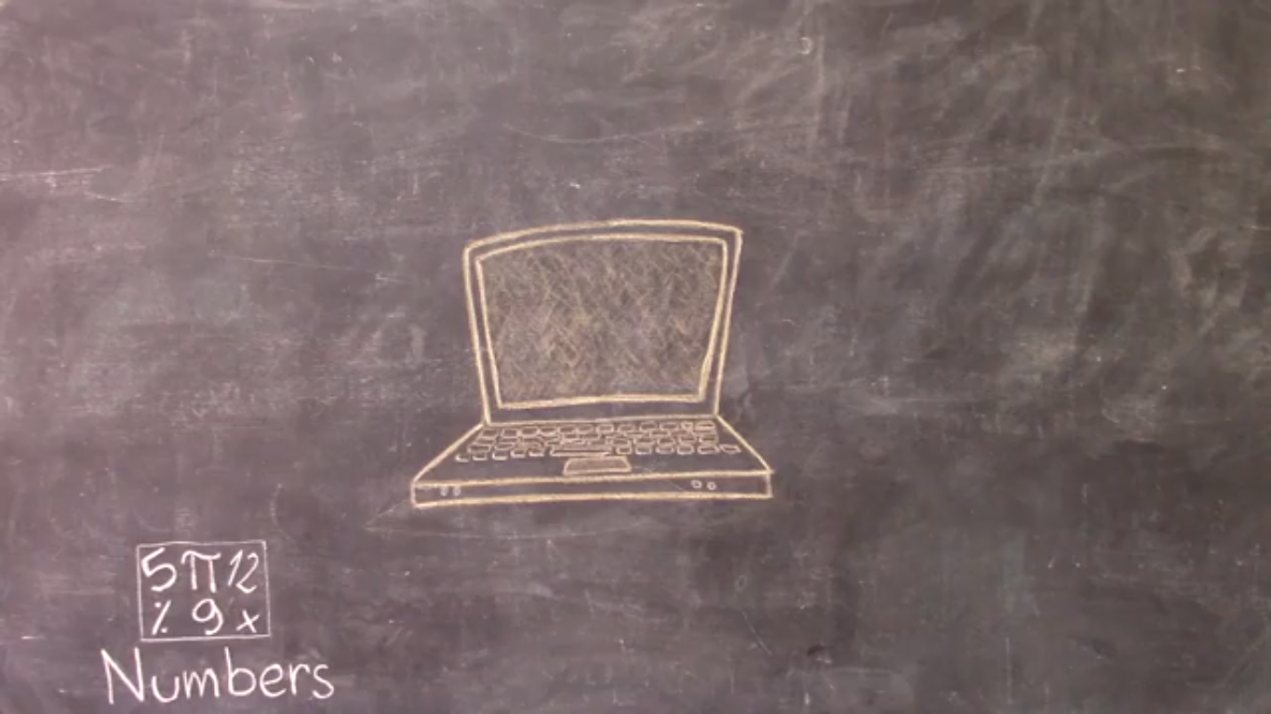
What can we find in a computer?

Slide 5
What can we find in a computer?

Slide 6
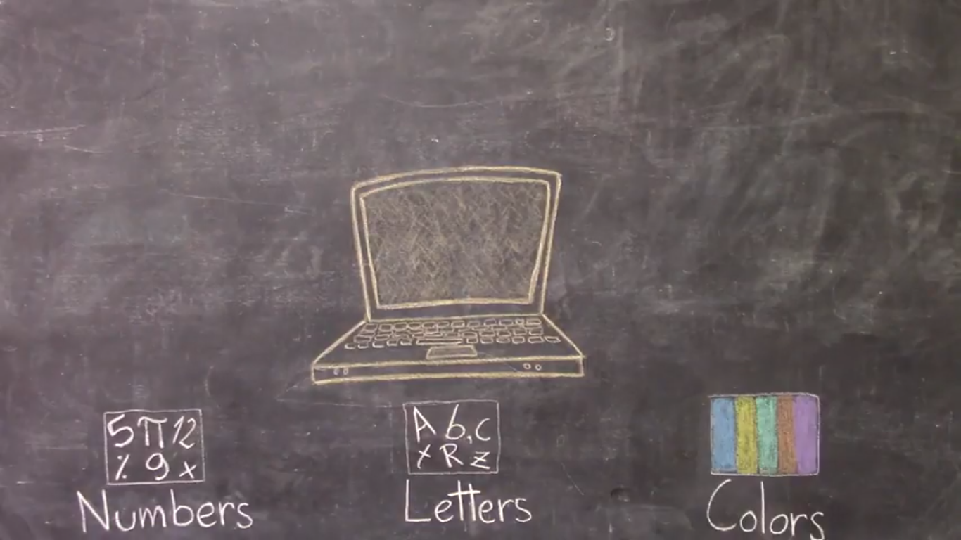
What can we find in a computer?

Slide 7
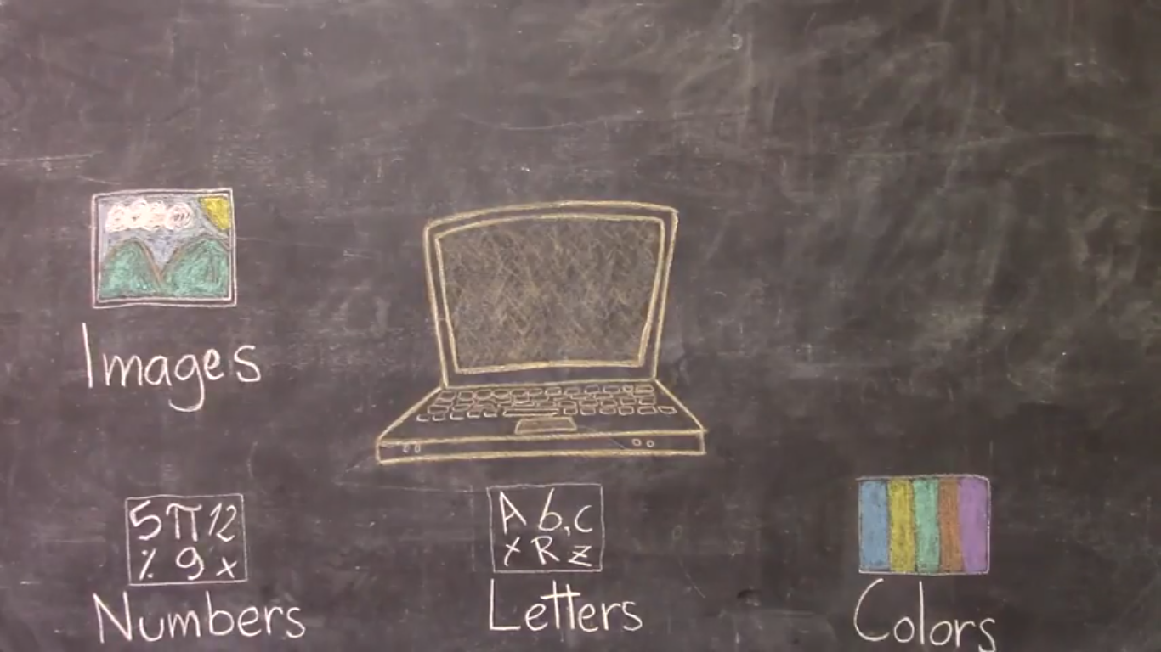
What can we find in a computer?

Slide 8
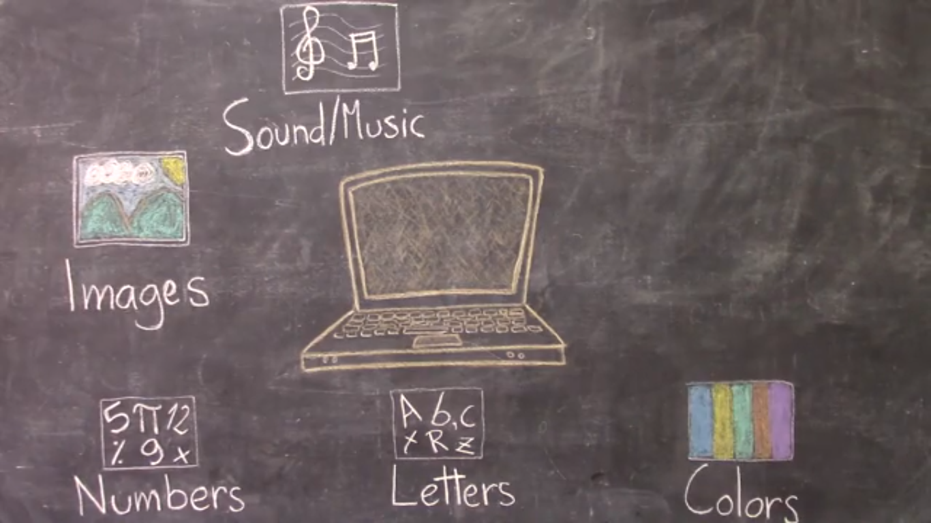
What can we find in a computer?

Slide 9
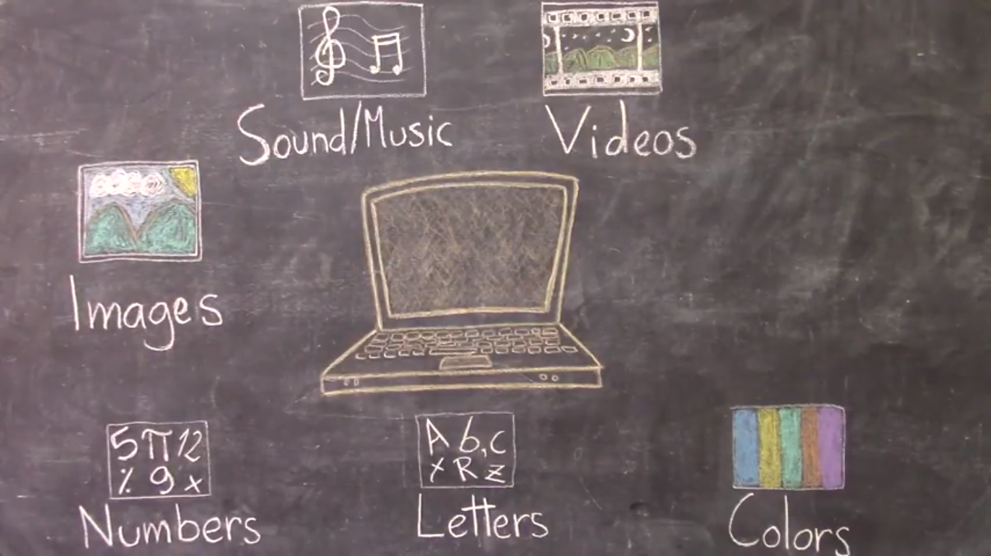
What can we find in a computer?

Slide 10
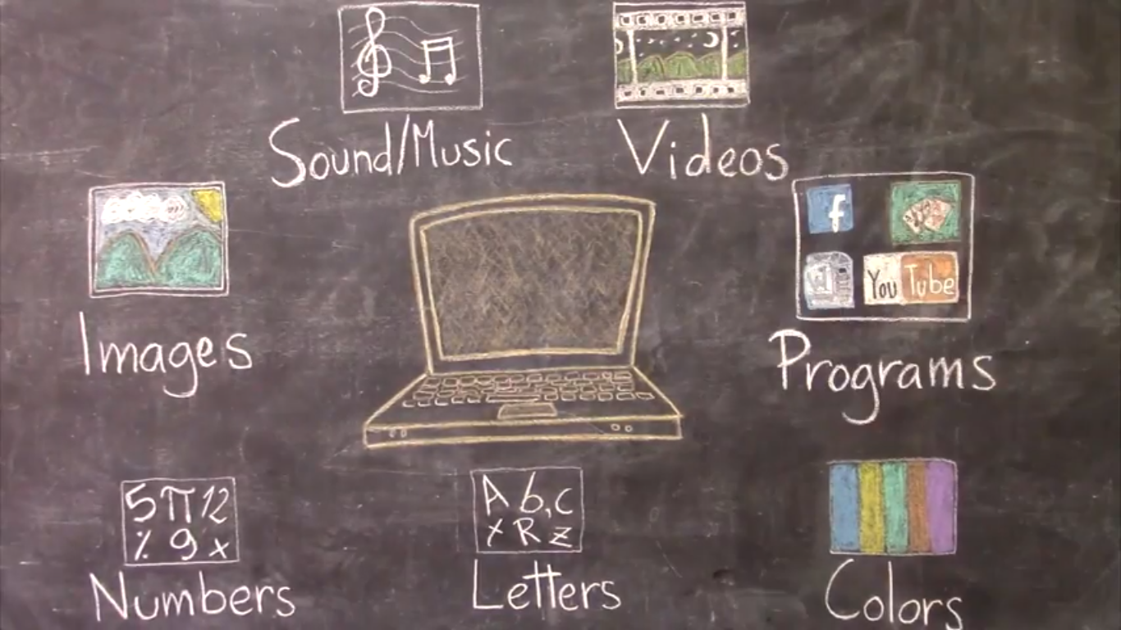
What can we find in a computer?

Slide 11
So, which are computers?

Slide 12
All of this is...

Slide 13
INFORMATION!

Slide 14
How does a computer store all this information?

Slide 15
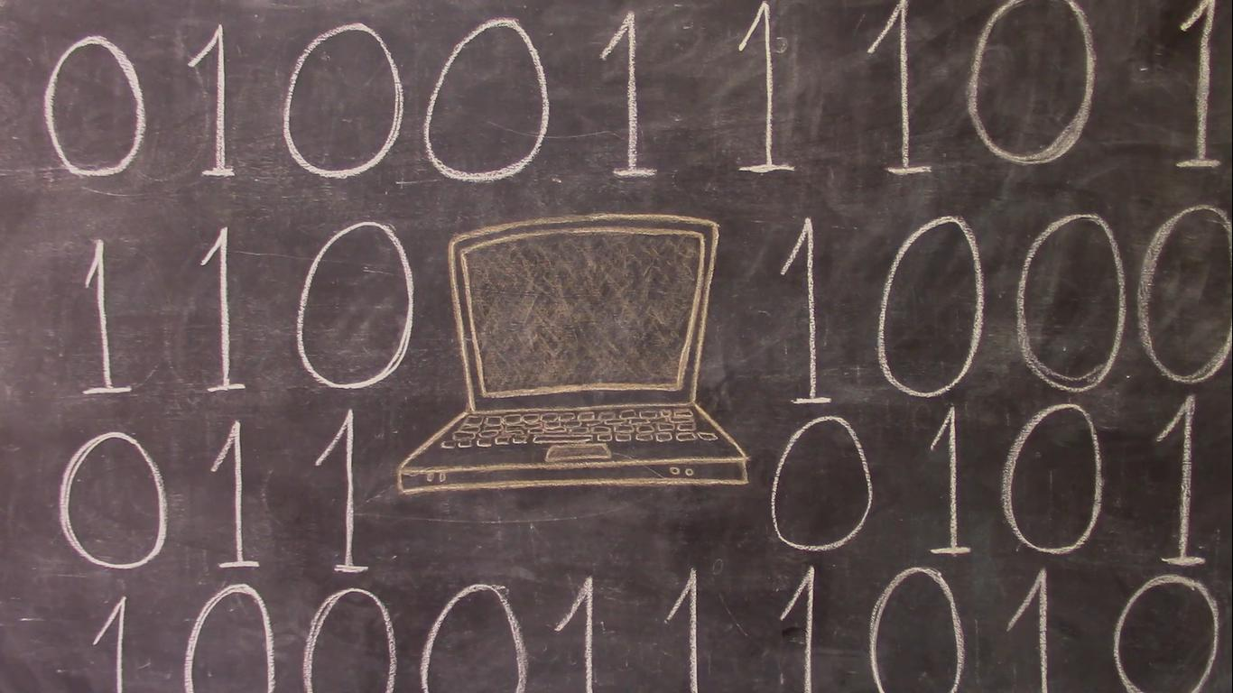
With 0s and 1s.

Slide 16
See you next class! ☺

