Slide 1
ARRIBADA CLUB
Pics and Pixels

Slide 2
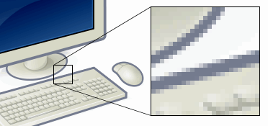
What is a pixel?
A pixel is A SINGLE POINT in a picture.

Slide 3
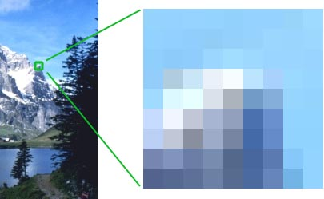
What is a pixel?
Each pixel has a single colour and all together the pixels form a picture.

Slide 4
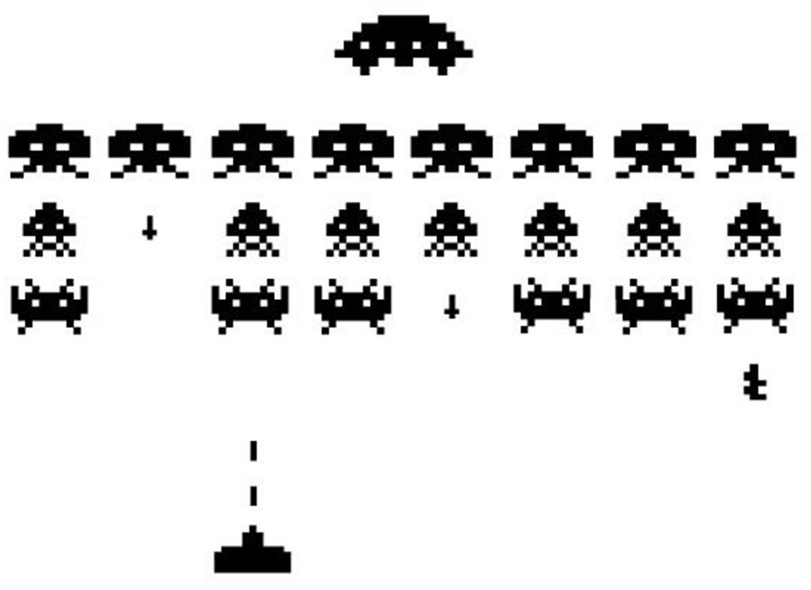
Colour Depth
Number of bits used to indicate the colour of each pixel.

Slide 5
0.White
1.Black
0 0 0 0 0 0 0
0 0 1 1 1 0 0
0 0 1 0 0 0 0
0 0 1 0 0 0 0
0 0 1 0 0 0 0
0 0 1 1 1 0 0
0 0 0 0 0 0 0

Slide 6
0.White
1.Black
0 0 0 0 0 0 0
0 0 1 1 1 0 0
0 0 1 0 0 0 0
0 0 1 0 0 0 0
0 0 1 0 0 0 0
0 0 1 1 1 0 0
0 0 0 0 0 0 0

Slide 7
00 10 10 10 10 10 00
00 10 11 11 11 10 00
00 10 11 11 11 10 00
00 10 10 10 10 10 00
00 00 00 10 00 00 00
00 10 10 10 10 10 00
10 10 10 10 10 10 10

Slide 8
0.White
1.Black
2.Blue
3.Green
00 10 10 10 10 10 00
00 10 11 11 11 10 00
00 10 11 11 11 10 00
00 10 10 10 10 10 00
00 00 00 10 00 00 00
00 10 10 10 10 10 00
10 10 10 10 10 10 10

Slide 9
0.White
1.Black
2.Blue
3.Green
00 10 10 10 10 10 00
00 10 11 11 11 10 00
00 10 11 11 11 10 00
00 10 10 10 10 10 00
00 00 00 10 00 00 00
00 10 10 10 10 10 00
10 10 10 10 10 10 10

Slide 10
010 010 010 010 010 010 110
010 010 010 100 010 010 010
010 010 100 100 100 010 010
010 100 100 100 100 100 010
010 010 000 000 000 010 010
010 010 000 101 000 010 010
011 011 011 011 011 011 011

Slide 11
0.White
1.Black
2.Blue
3.Green
4.Orange
5.Red
6.Yellow
7.Brown
010 010 010 010 010 010 110
010 010 010 100 010 010 010
010 010 100 100 100 010 010
010 100 100 100 100 100 010
010 010 000 000 000 010 010
010 010 000 101 000 010 010
011 011 011 011 011 011 011

Slide 12
0.White
1.Black
2.Blue
3.Green
4.Orange
5.Red
6.Yellow
7.Brown
010 010 010 010 010 010 110
010 010 010 100 010 010 010
010 010 100 100 100 010 010
010 100 100 100 100 100 010
010 010 000 000 000 010 010
010 010 000 101 000 010 010
011 011 011 011 011 011 011

Slide 13
See you next class! ☺

